Slide 1


Introduction to Scrum
Dr. Michael Robbeloth
Online Demo Lesson
April 24, 2025
Notes:
"Imagine starting a journey to a destination you've never been to, with the map constantly changing and new roadblocks appearing unexpectedly. How do you ensure you still reach your goal efficiently and effectively? In the world of product development and complex projects, we often face this exact challenge. Today, we're going to look at a framework called Scrum that helps teams navigate this unpredictable terrain."

Slide 2
ACM CS Curricular Guidelines
An Introduction to Scrum best fits within the Software Engineering Teamwork Knowledge Unit
Part of CS Core (2+3 hours) and/or KA Core (2 hours) Topics
One outcome will involve articulating how to use Scrum as a best team communication practice
Another outcome will involve articulating how to use the Scrum process to manage conflict and the problem-solving process through the daily standups, review, and retrospective
A final outcome will involve articulating how to engage with stakeholders to create and execute a plan for the upcoming sprint.

Slide 3
ABET Learning Outcomes Covered
CS 5 Function effectively as a member or leader of a team engaged in activities appropriate to the program’s discipline
SE 3 An ability to communicate effectively with a range of audiences;
SE 5 An ability to function effectively on a team whose members together provide leadership, create a collaborative and inclusive environment, establish goals, plan tasks, and meet objectives;
SE 6 An ability to develop and conduct appropriate experimentation, analyze and interpret data, and use engineering judgement to draw conclusions;

Slide 4

Agenda
Introduction
Core Concepts
The Three Pillars
The Five Values
The Team
Components of a Sprint
Key Benefits
Key Takeaways

Slide 5

Notes:
Scrum gets its name from the sport of rugby, where the team comes together in a scrum to work together to move the ball forward. There is an opposing team to move through, and potential adverse weather conditions.
Like this scene, software development teams can face a number of obstacles to the delivery of a software system that can deliver value to all the relevant stakeholders.
Also, note that both effective rugby teams and effective software teams require cohesive teamwork, continuous effort, and an ability to adapt to changing conditions and the strategies of their competitors

Slide 6

Introduction
Lightweight, powerful, agile framework
Helps teams deliver creative and viable solutions
Delivers value incrementally
Offers adaptability based on observation, experimentation and feedback
Notes:
Lightweight, powerful framework that helps teams work together to deliver creative digital solutions to problems
Developed in mid 90s by Ken Schwaber and Jeff Sutherland to better solve complex problems enterprises were facing
Traditional waterfall processes were getting in the way, leading to cancelled or delayed projects that exceeded allocated budgets, a losing prospect.

Slide 7

Core Concepts
A framework, not an instruction manual
Iterative process w/ sprints
Use empirical controls (e.g., observation and experiments)
Requires everyone to learn from their experiences and adapt
Requires trust
Notes:
Scrum is a framework, not an instruction manual.
It is an iterative process with sprints lasting 1 -4 weeks, utilizing empirical techniques such as observations and experiments.
It requires stakeholders, such as developers, to learn from their experiences
It requires stakeholders to trust those from other stakeholder groups (devs need to trust project managers, clients, end users, support personnel, etc.)
A lack of trust leads to tension and bottlenecks, potentially impacting culture negatively if it persists long-term

Slide 8
The three pillars
Transparency
Inspection
Adaptation
Notes:
To that end, scrum has three pillars
Transparency: Visible and understood process and work.
Inspection: Regularly checking progress towards goals.
Adaptation: Adjusting the process or product based on inspection.

Slide 9
The five values
Courage
Focus
Commitment
Respect
Openness
Notes:
Stakeholders working in a scrum environment have to:
Have courage -- do the right thing and have a willingness to work on tough problems when there might be inertia to doing so.
Have focus – keep your eyes on the current sprint and work through the user requirements and stories that need to be completed.
Have commitment – willing to work toward the goals of the team
Have respect – see every stakeholder as a professional, capable of completing their work w/o oversight from others
Have openness – be forthright about what is going well, where you are having issues, and how others can help you out.

Slide 10

The Team
The team consists of:
Scrum Master
Product Owner
Developers
Notes:
Product Owner: Maximizes the value of the product, manages the Product Backlog. (Focus on what needs to be built).
Scrum Master: Facilitates the Scrum process, removes impediments, and coaches the team. (Focus on how the team works).
Development Team: Cross-functional individuals who build the Increment. (Focus on building the product)

Slide 11
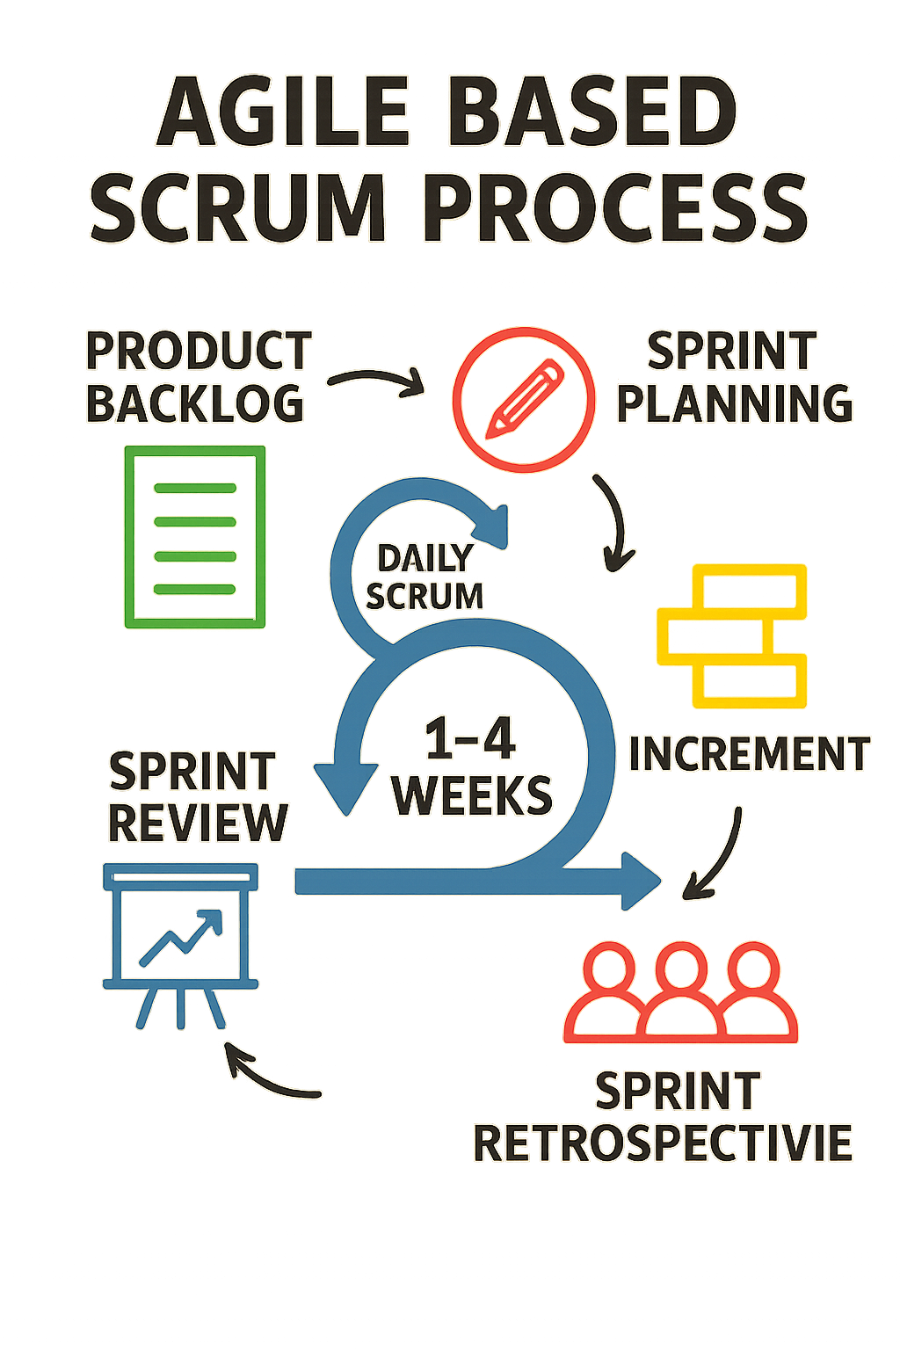
Components of a Sprint
Stakeholders start with a product backlog
Stakeholders generate a sprint backlog from the product backlog
Stakeholders develop a plan to turn the backlog into a working, deliverable increment
Stakeholders participate in five events
Stakeholders produce three artifacts
Stakeholders hold daily scrums during the sprint
Stakeholders hold a review after the increment is delivered
Stakeholders hold a retrospective after the review
Notes:
Product backlog -- Prioritized list of everything that might be needed in the product.
Sprint backlog -- Subset of the Product Backlog selected for a Sprint, plus the plan for delivering it.
Overall Events -- time-boxed opportunities for inspection and adaptation
Scrums -- Daily quick sync for the Development Team.
Increment: The "Done," a usable product resulting from a Sprint. Each sprint creates an increment that adds to the last one.
Done has somewhat different meanings to different teams, but some form of all testing completed, no known defects, code review completed and passed, approvals secured, etc.
Reviews – inspect the outcome of an increment and adapt the product backlog -- timeboxed to a maximum of four hours for a one-month Sprint
Retrospectives – post-mortem of the sprint increment and plan improvements for the next sprint (what went well, what could be improved, what we will commit to in the next sprint)

Slide 12

Key Benefits
Increased flexibility and adaptability to change.
Improved team collaboration and self-organization.
Faster delivery of value to customers.
Enhanced transparency and visibility of progress.

Slide 13

Key Takeaways
Notes:
In summary, Scrum is a lightweight yet powerful framework that helps teams tackle complex problems by delivering value in short, iterative cycles called Sprints.
It's built on the pillars of transparency, inspection, and adaptation, brought to life through defined roles like the Product Owner, Scrum Master, and Development Team, specific events for planning and review, and essential artifacts like the Product Backlog.
By embracing Scrum, teams can enhance collaboration, respond effectively to change, and consistently deliver valuable increments of a product.

